Slide 1






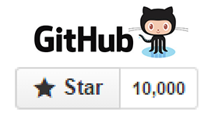
KNOWLEDGE MAVENS
Find us out on Social Media!

Slide 2

HELLO,
LET ME INTRODUCE MYSELF…
Organizer
Teacher
Programmer
My name is Garrett Broughton. I am happiest when I’m learning. If I could choose a super power, I would be Neo from the Matrix. I love to learn and teach anything to help people solve problems.

Slide 3
AGENDA
1:00
PM
1:45
PM
INTRODUCTIONS
Like to Share?
Let’s get to know each other. What’s your current need?
Do you have knowledge you’re passionate about? Why not share it with the community?
1:15
PM
1:55
PM
Demo
Vote
Enjoy Valuable Information? Our 20 minute demo will be worth your time.
Let’s see what’s most interesting
1:35
PM
2:00 PM
Q&A
Be Inspired!
Have questions?
We hope you leave inspired to work on your project.

Slide 4

JavaScript?
Why
Notes:
No slide master

Slide 5




Java is JavaScript as Ham is to Hamburger
Is Java
the same as JavaScript?
Originally named LiveScript or ECMAScript. Changed name for better marketing.
Front End vs Backend
JavaScript is mostly frontend. Node.js has enabled full-stack development.
Java is backend and can run on the frontend with Java applets.
Interpreted vs Compiled
JavaScript is a scripting language any browser can read.
Java uses a compiler and runs as an .exe or .jar
Web Development
I’m choosing JavaScript due to the power of processing on the client side. Web development has exploded because of the feature-rich content due to hardware processing of laptop and mobile.

Slide 6
Web Development
HTML
HTML + CSS
HTML + a little JS
Evolution & Prerequisites
HTML + a lot of JS
JS

Slide 7
Basics
Variables
Printing & Commenting
Functions
What We’ll Cover
Assignment
Operators
Math
Operators
In order to learn the basics, it’s best to start with syntax for print, comments, variables, functions, math operators, scope, assignment operators, and many more to cover if we have time.
Scope

Slide 8
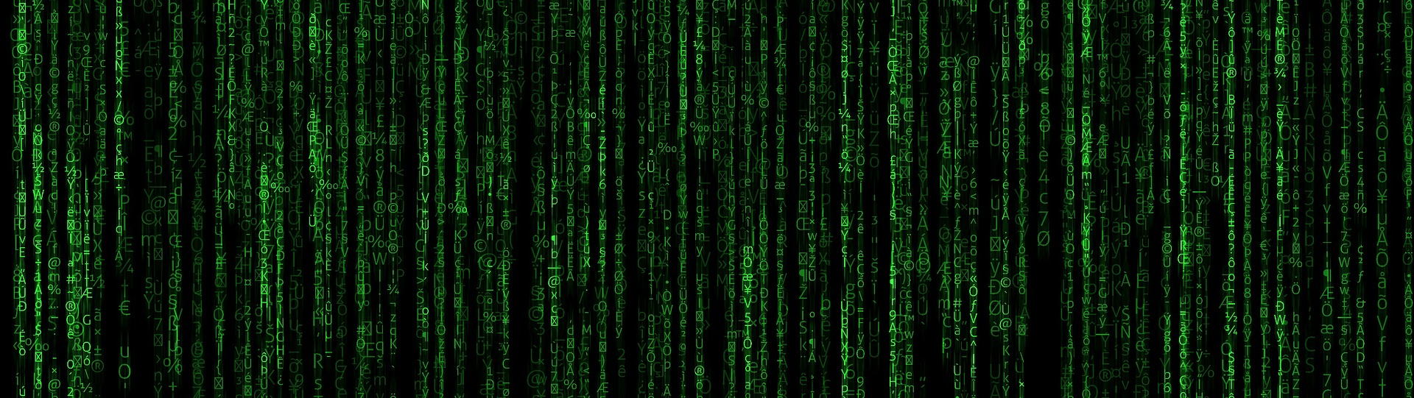
DEMO
Let’s dive into the Matrix!

Slide 9
Q&A?

